Slide 2
Overview of Presentation
ABCG overview
Global Change Impacts task group objectives
Surveys - methodology and results
Climate data - observed and projected
Typology of human responses
Mapping exposure of human communities at target sites
Notes:
Through collaboration and resource sharing, we pursue a vision of Africa where natural resources and biodiversity are conserved in balance with sustained human livelihoods.

Slide 3
Mission
To advance understanding of critical biodiversity conservation challenges and their solutions in sub-Saharan Africa
We aim to produce practical knowledge and put it into practice.

Slide 4
Current Phase
ABCG II cooperative agreement, Oct 2015-Sept 2018
$5 million over 3 years
Emphasis on capacity development of African institutions
Nairobi-based Communications and Engagement Officer
WCS hosts the Secretariat, housing full-time ABCG staff

Slide 5
Objectives
Prioritize biodiversity conservation in international development agendas
Promote best practices for conservation among practitioners
Partner with social and development institutions, including African institutions and civil society, to build capacity for biodiversity conservation
Notes:
Three main strategies for achieving this vision, include: 1) prioritizing biodiversity conservation in international development; 2) promoting good conservation practices, and; 3) partnering with social and development institutions in biodiversity conservation.
Each of these strategies is applied to key themes that are supported by USAID’s biodiversity policy.

Slide 6
Approach
Identify and prioritize emerging and high-priority conservation issues affecting sub-Saharan Africa;
Foster technical and information exchange through partnerships with African institutions and civil society, to design and test innovative approaches and build communities of practice, and;
Synthesize collective lessons from field activities and share them with a broader multi-sector community in the US and Africa for data-driven decision making and policy integration.

Slide 7
Thematic Activity Areas
Land and Resource Tenure Rights
Land Use Management
Managing Global Change Impacts on Biodiversity
Global Health Linkages to Biodiversity Conservation
Emerging Issues
Notes:
Land and Resource Tenure Rights
Create favorable conditions for individual and community initiatives that support biodiversity conservation
Land Use Management
Improve the effectiveness of investments in biodiversity conservation by leveraging a smart conservation planning framework.
Managing Global Change Impacts on Biodiversity
Analyze information on human responses to climate change and identify ecosystem-based adaptation strategies
Global Health Linkages to Biodiversity Conservation
Improve conservation and human well-being by implementing integrated biodiversity and global health program design
Emerging Issues
Identify emerging threats, issues and/or opportunities, convene stakeholders and catalyze discussion

Slide 8
Connect
ABCG website: www.abcg.org
Join our listserv
Twitter: @ABCGconserve
Facebook: www.facebook.com/ABCGconserve
LinkedIn:www.linkedin.com/company/africa-biodiversity-collaborative-group
Notes:
If you have not already joined our listserv, please visit our website. You’ll receive monthly announcements about our speaker series and other upcoming events and workshops. These are some of the best opportunities for USAID staff to engage with us. We hope to see you there.
Now, we have about 40 min for questions.

Slide 9
Community Adaptation to Climate Change: the Indirect Impacts on Biodiversity Across Africa
Global Change Impacts Working Group

Slide 10
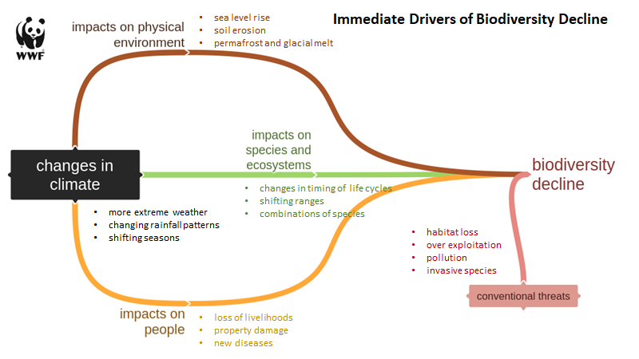
Climate impacts on biodiversity
Notes:
Through collaboration and resource sharing, we pursue a vision of Africa where natural resources and biodiversity are conserved in balance with sustained human livelihoods.

Slide 11
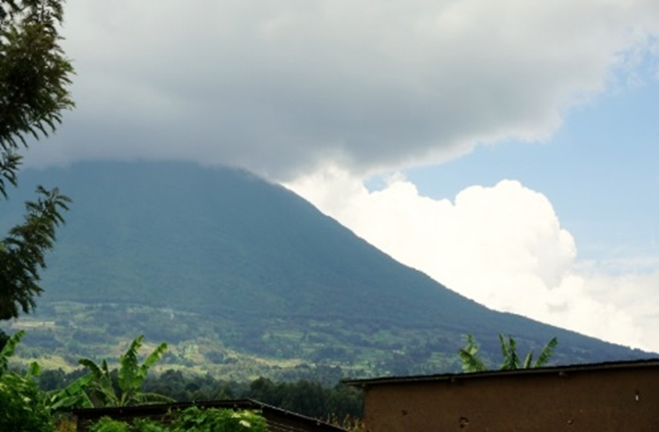
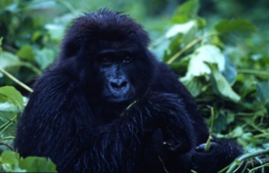
Mountain gorillas and water
https://www.worldwildlife.org/initiatives/wildlife-and-climate-change
Notes:
Through collaboration and resource sharing, we pursue a vision of Africa where natural resources and biodiversity are conserved in balance with sustained human livelihoods.

Slide 12
Collect data on...
The kinds of changes vulnerable communities are experiencing
How they are responding to these changes
How their responses are impacting biodiversity
Notes:
Through collaboration and resource sharing, we pursue a vision of Africa where natural resources and biodiversity are conserved in balance with sustained human livelihoods.

Slide 13
Survey sites
https://www.wwfclimatecrowd.org/
WWF
§ Masaai Mara, Kenya (45 surveys [DW1] completed) (see annex for summary report)
§ Sesheke, Zambia (53 surveys completed)
§ Kunene region, Namibia (28 surveys completed)
§ Western Madagascar (33 surveys completed)
TNC
§ Monduli District, Tanzania (completed)
§ Kiteto District, Tanzania (completed)
JGI
§ Gombe - Masito – Ugalla, Western Tanzania (90 surveys completed)
§ Budongo and Bugoma, Western Uganda (80 surveys completed)
WRI
§ Matutuíne District-Maputo Province, Mozambique (completed)
§ Chókwè District-Gaza Province, Mozambique (completed)
CI
§ CAZ (Corridor Ankeniheny Zahamena) East and West sides, Madagascar (completed)
§ COFAV (Corridor Fandriana Vondrozo), Madagascar (completed)
AWF
§ Maringa Lopori Wamba, DRC (22 surveys completed)
§ Kilombero Valley, Tanzania (85 surveys completed)
§ Bili Mbomu, DRC (40 surveys completed)
§ Mana Pools, Zimbabwe (surveys underway. Expect completion by Nov ‘17)
WCS
§ Mbam Djerem National Park, Cameroon (completed, pending data compilation and English translation – 120 interviews)
§ Ivindo National Park, Gabon (completed – 40 interviews)
§ Loango National Park, Gabon (completed – 50 interviews)
Notes:
Through collaboration and resource sharing, we pursue a vision of Africa where natural resources and biodiversity are conserved in balance with sustained human livelihoods.

Slide 14
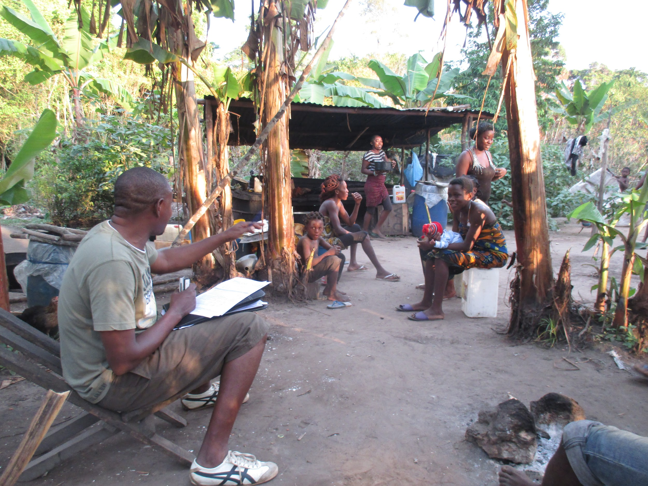
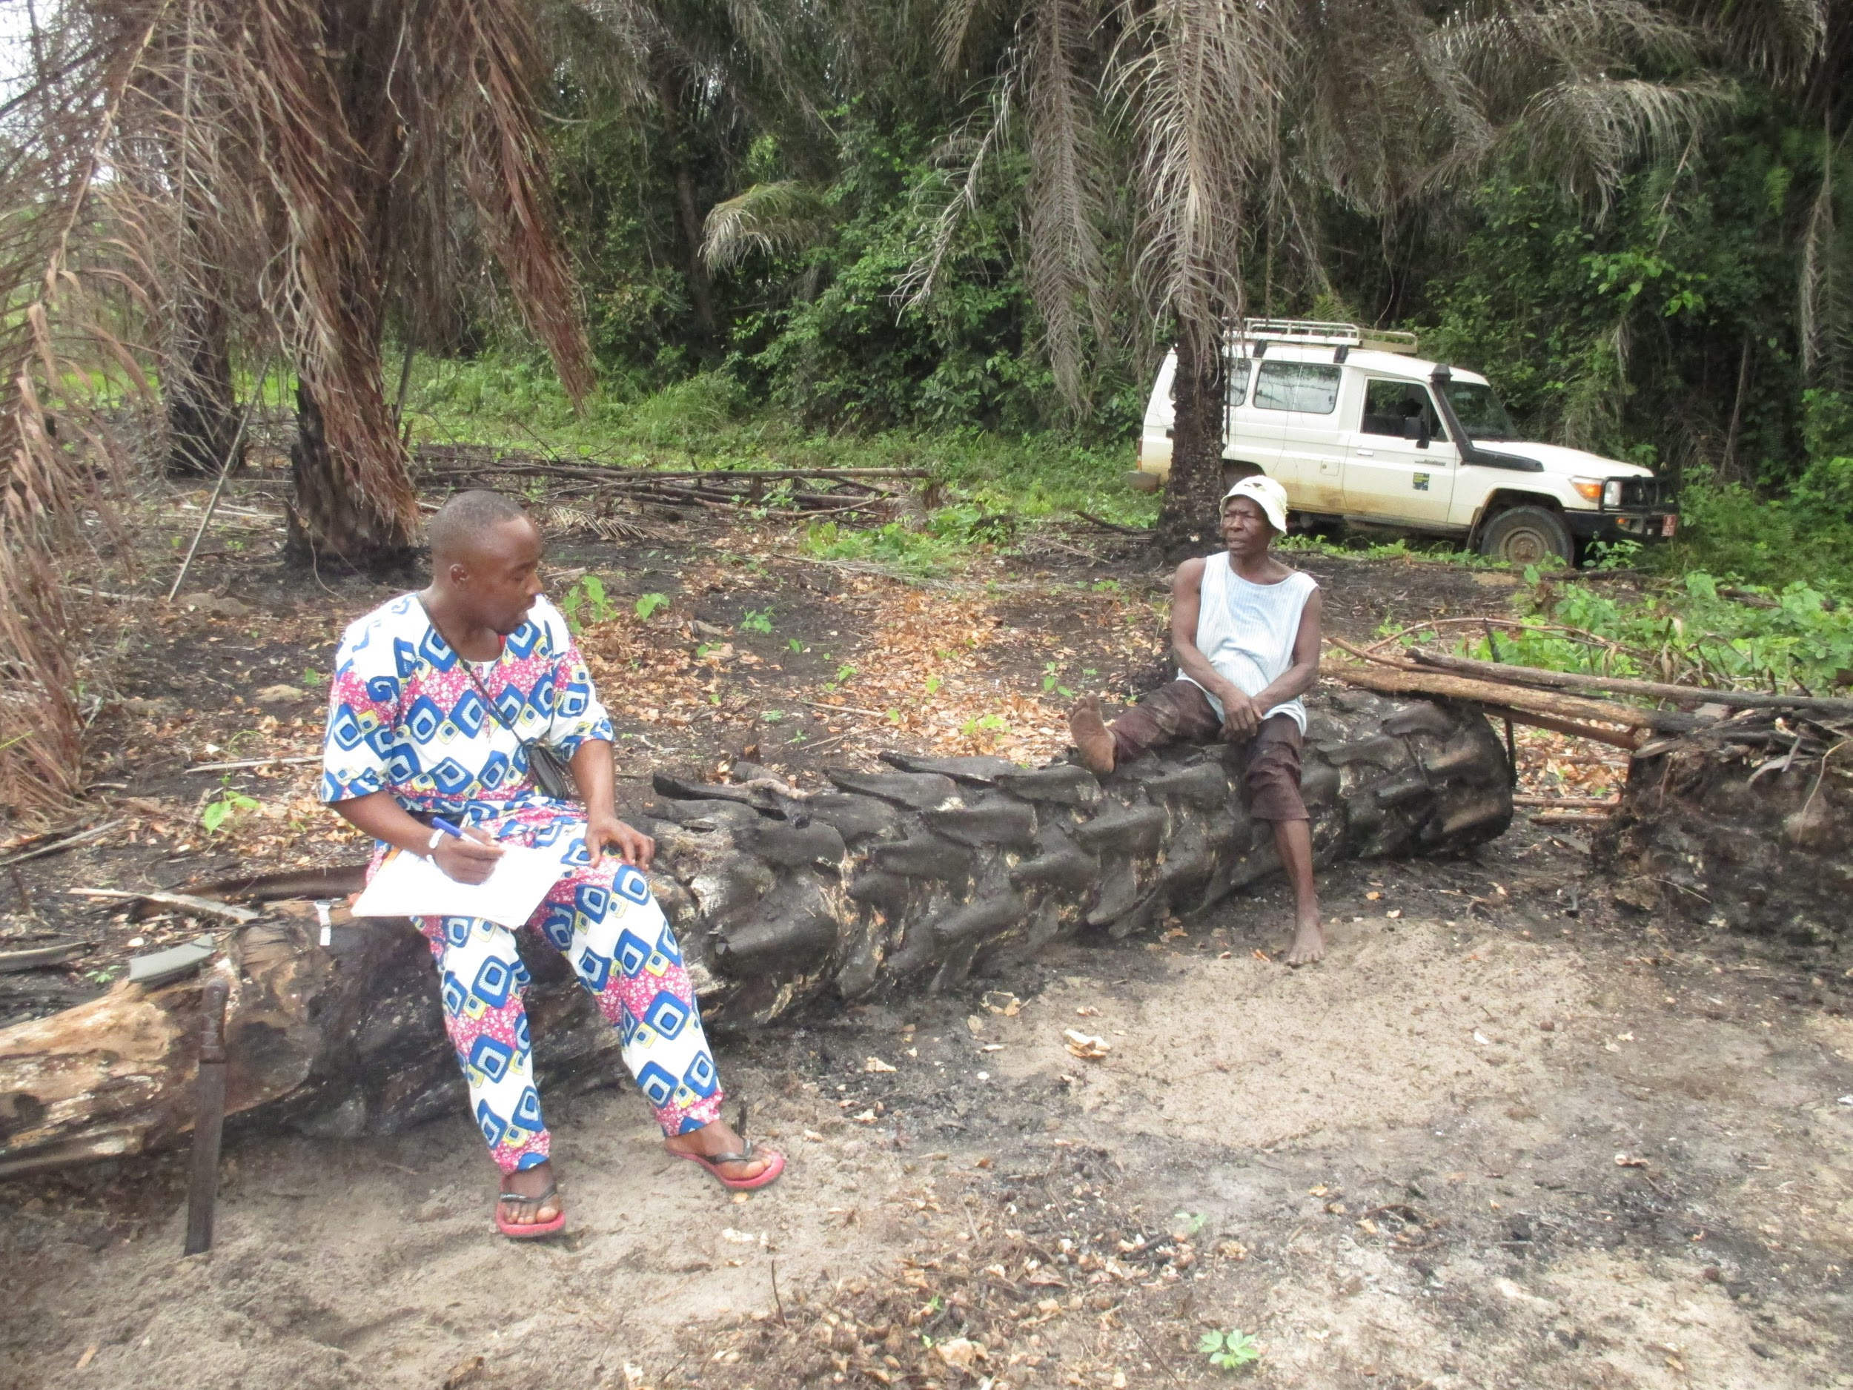
Surveys - WCS Gabon

Slide 15
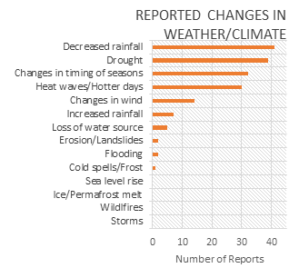
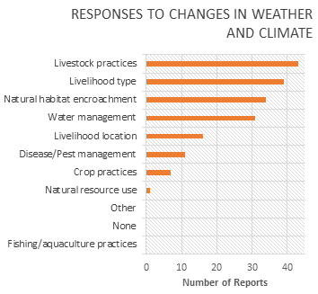
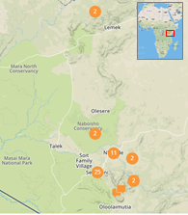
Kenya: Summary of findings
Notes:
Through collaboration and resource sharing, we pursue a vision of Africa where natural resources and biodiversity are conserved in balance with sustained human livelihoods.

Slide 16
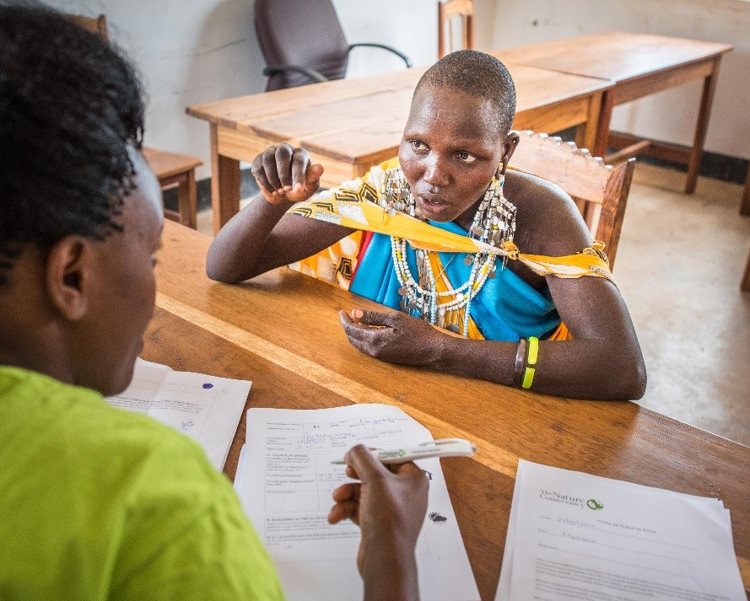
Typology of Human Responses

Slide 17
Typology of human responses
Purpose: to organize the suite of responses gathered through the surveys with key informants into types
Typology will be used to:
help map where certain responses are happening now
help map where those responses may happen in the future
anticipate where certain responses may happen and suggest alternative ones
Notes:
...and ultimately anticipate where….

Slide 18
Preliminary results - Responses
122 surveys analyzed to date (17%)
630 responses to impacts caused by perceived changes in weather or climate
Example of a response in Kenya:
Perceived Climate threat: drought, high temperature and low rainfall
Impact: lack of water for consumption
Response: get water from springs
Potential impact on biodiversity: forest/water body disturbance, conflicts with wildlife

Slide 19
Preliminary results - Typology
Identified 34 unique responses
Are associated with decreased livestock productivity, crop productivity and water availability
Responses mainly include:
adaptation strategies related to changes in behavior:
migrating, changing to a different livelihood, using more resistant seeds and breeds
Coping strategies
logging, hunting, encroaching to conservation areas/forest to look for pasture or water

Slide 20
Preliminary results - Typology
Identified 34 unique responses
Are associated with decreased livestock productivity, crop productivity and water availability
Responses mainly include:
adaptation strategies related to changes in behavior:
migrating, changing to a different livelihood, using more resistant seeds and breeds
Coping strategies
logging, hunting, encroaching to conservation areas/forest to look for pasture or water
neutral impact on biodiversity, or context -dependent
negative impact on biodiversity

Slide 21
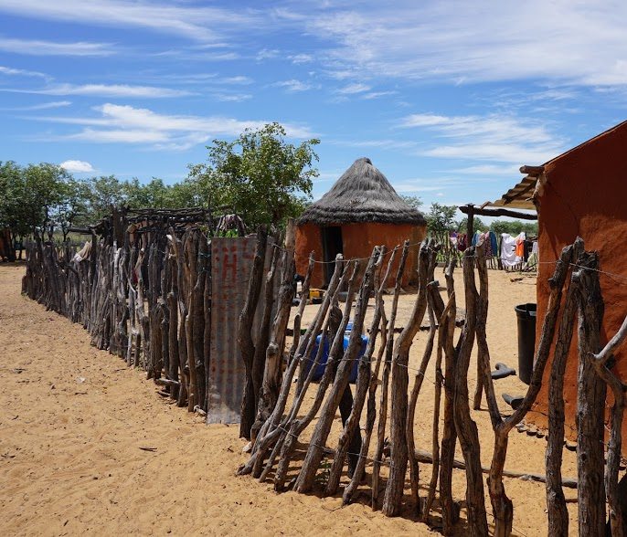
Mapping exposure of human communities at target sites

Slide 22
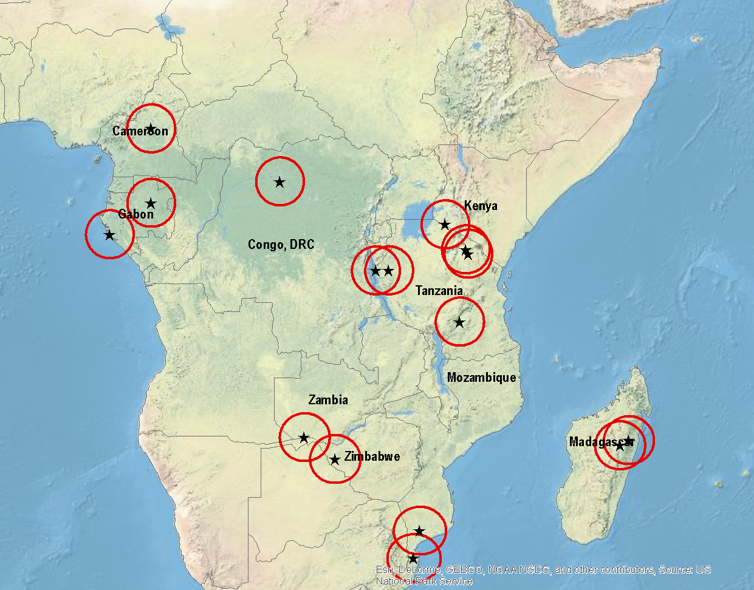
ABCG Survey Sites

Slide 23
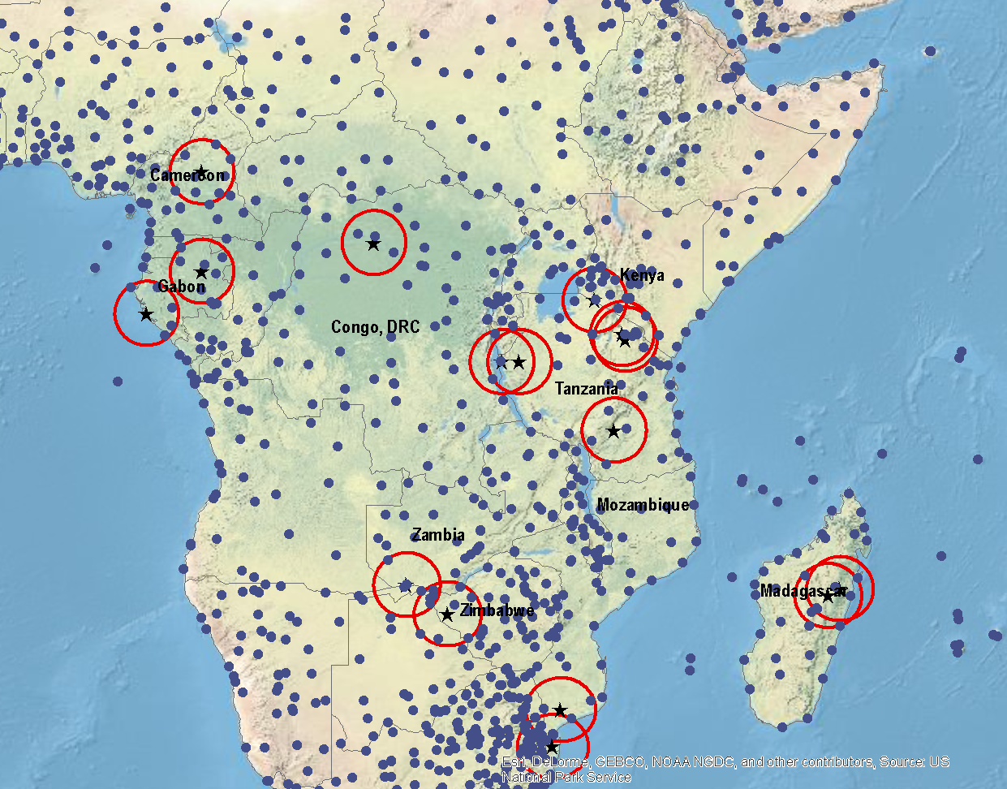
Historic Meteorological Weather Stations

Slide 24
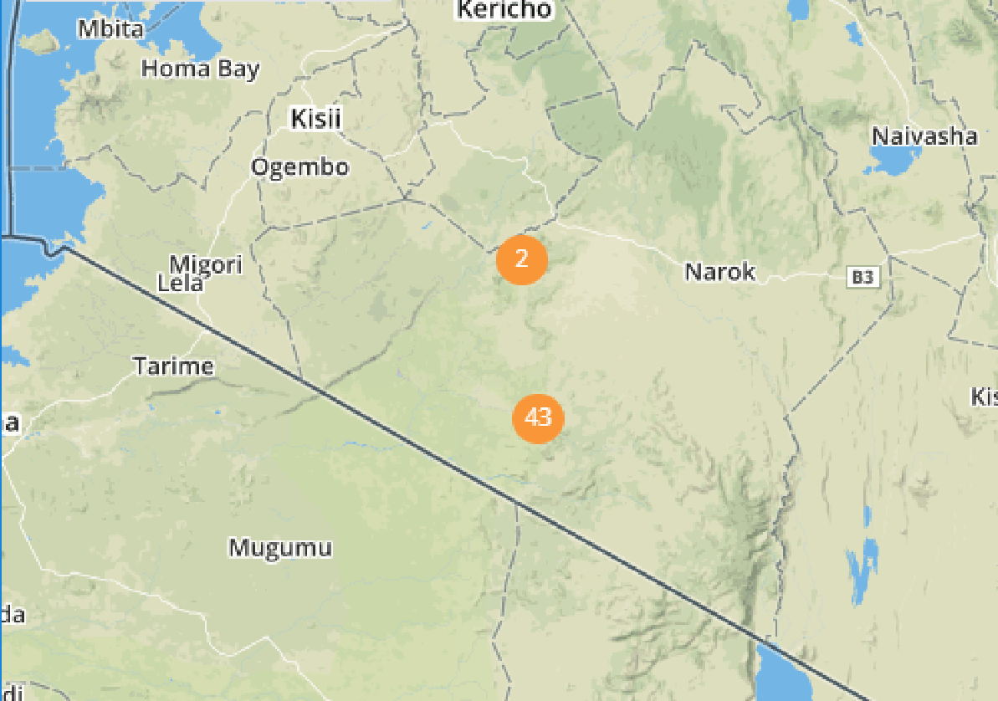
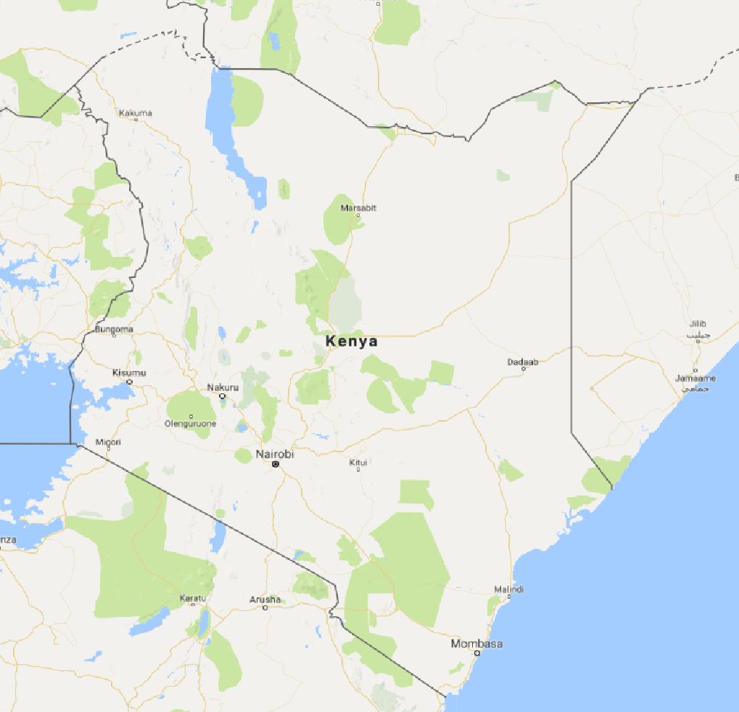
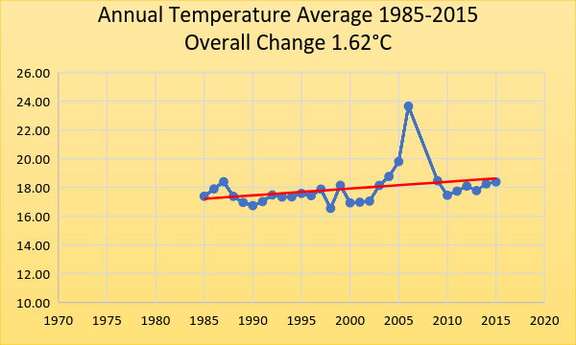
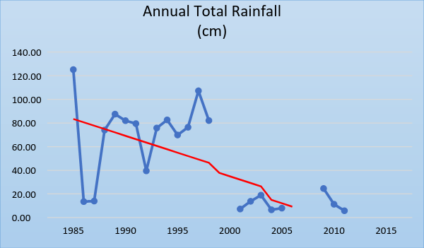
ABCG Survey Sites – Kenya (Masai Mara) Temperature & Rainfall trends – 1985-2015
Survey Locations
Meteorological Station

Slide 25
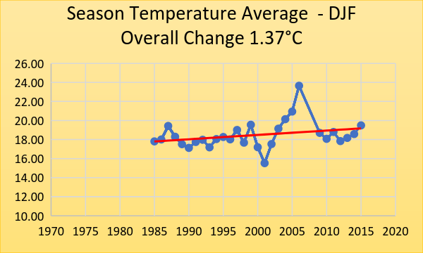
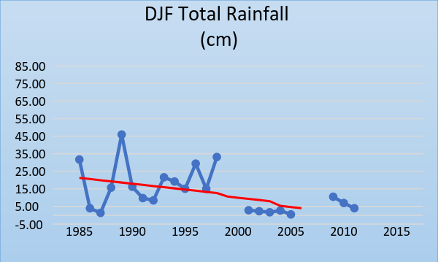
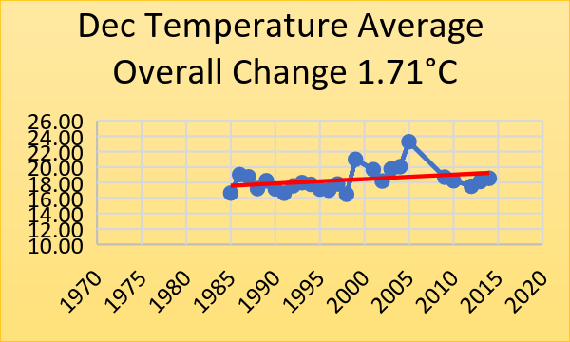
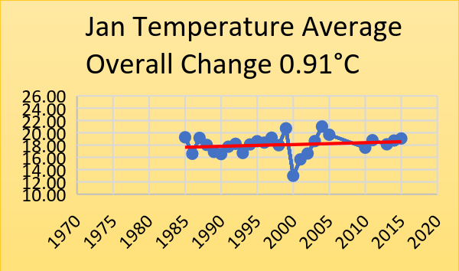
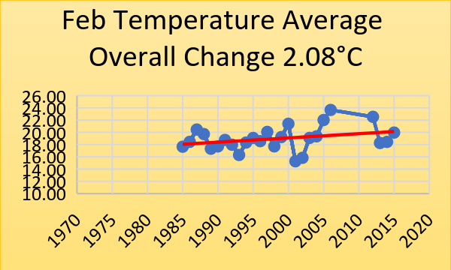
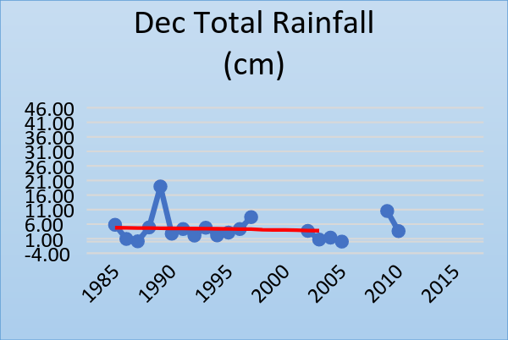
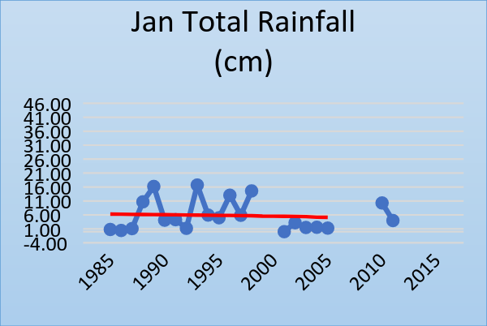
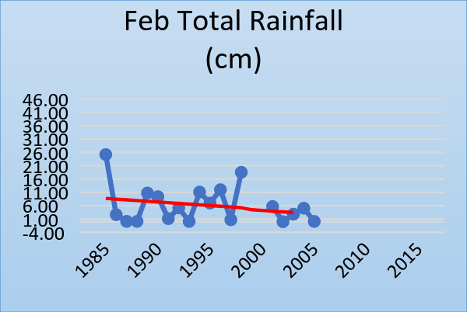
Dec, Jan, Feb – Kenya (Masai Mara) Temperature & Rainfall trends – 1985-2015

Slide 26
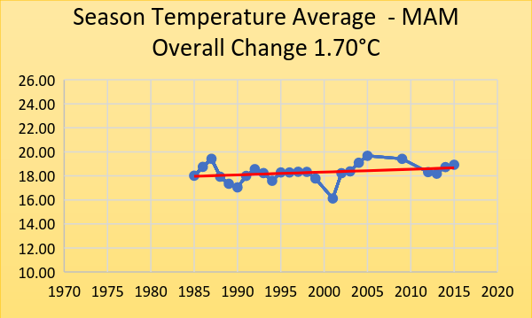
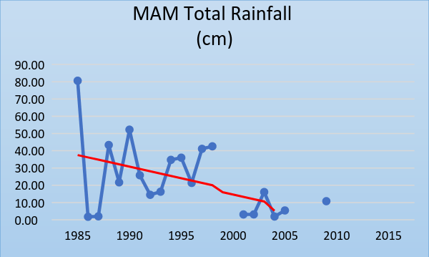
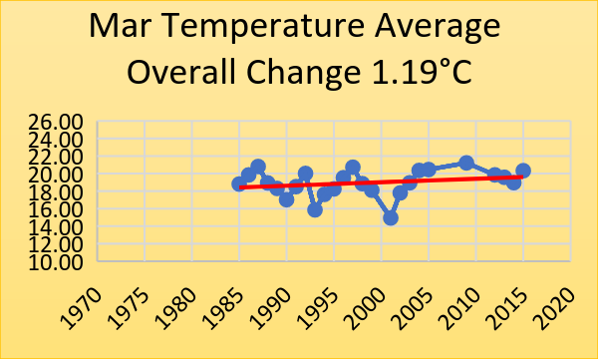
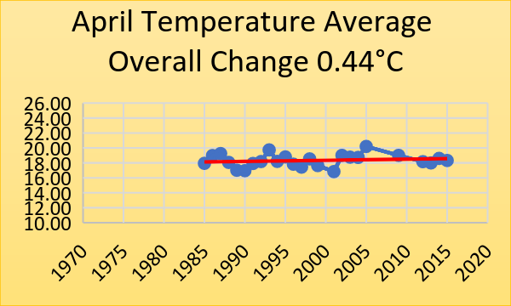
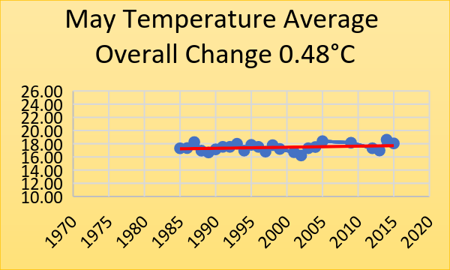
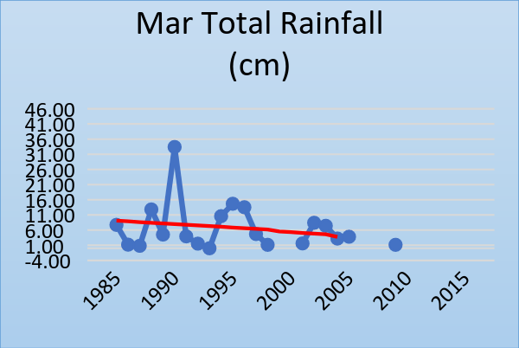
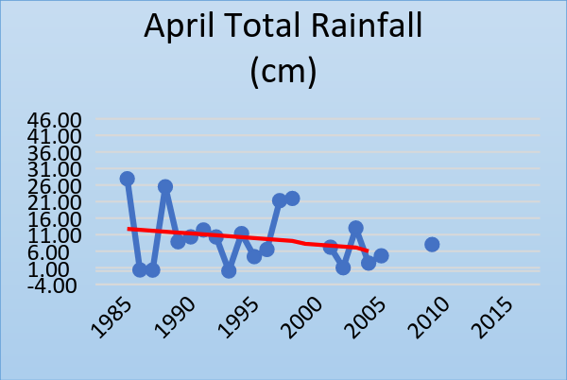
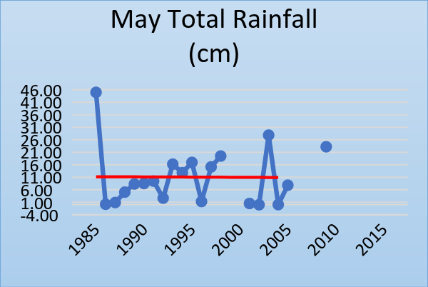
March, April, May – Kenya (Masai Mara) Temperature & Rainfall trends – 1985-2015

Slide 27
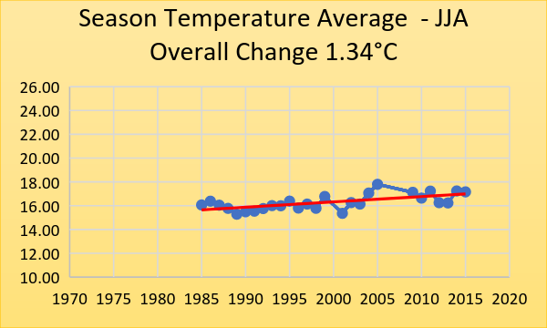
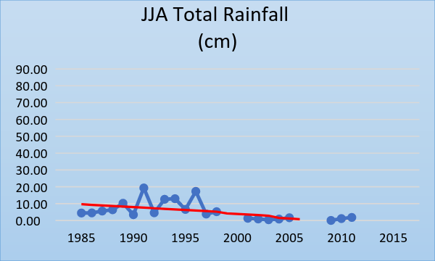
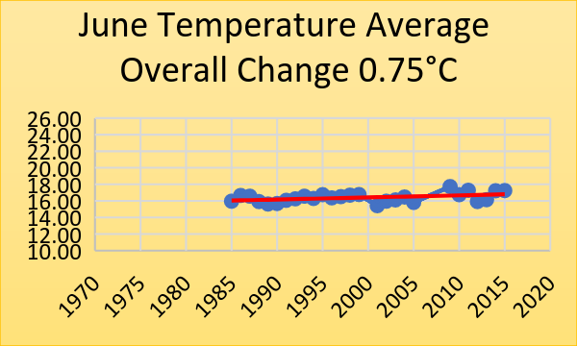
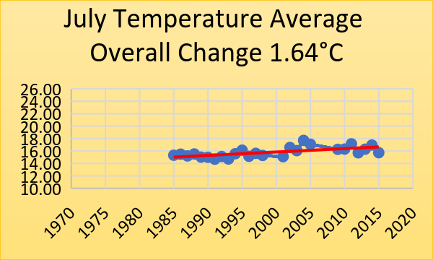
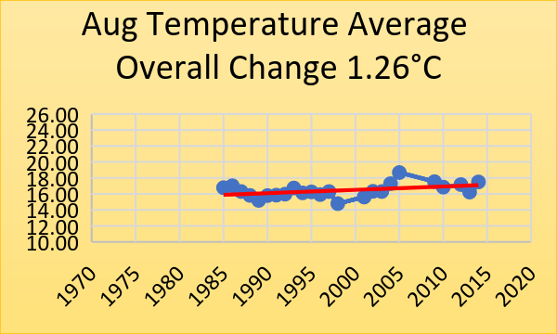
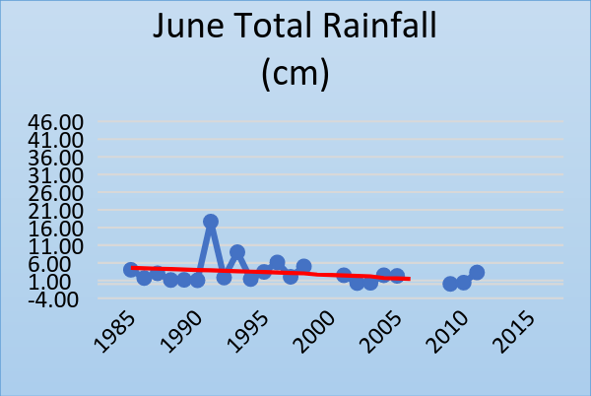
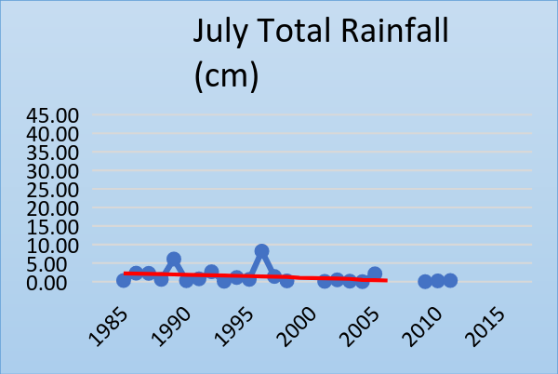
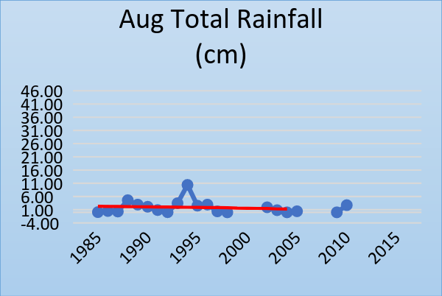
June, July, Aug – Kenya (Masai Mara) Temperature & Rainfall trends – 1985-2015

Slide 28
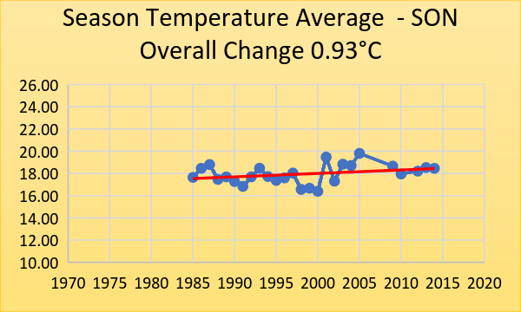
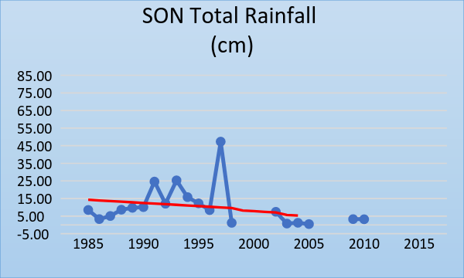
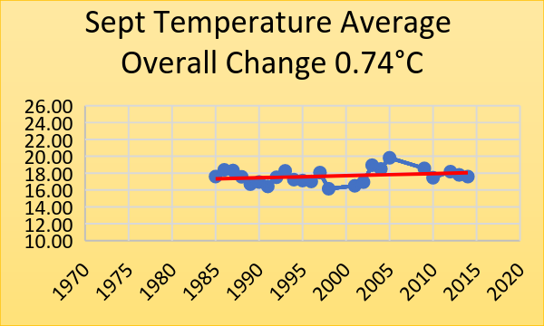
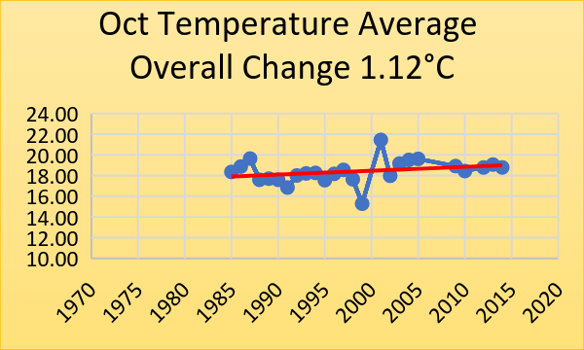
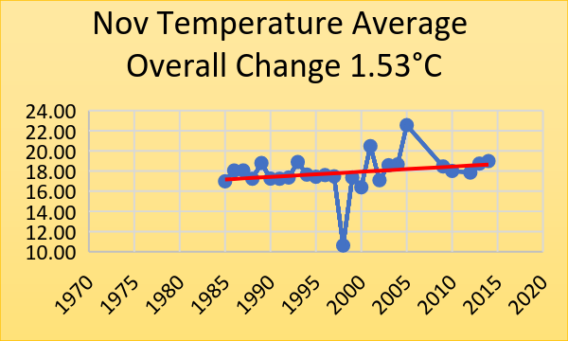
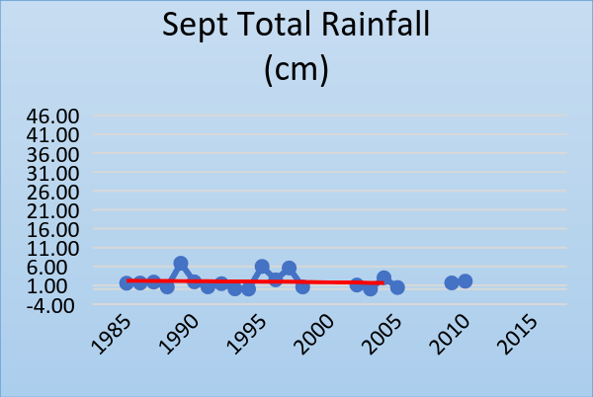
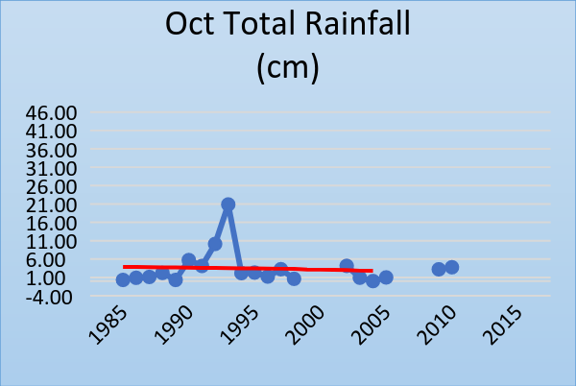
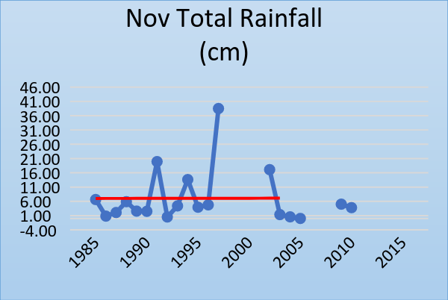
Sept, Oct, Nov – Kenya (Masai Mara) Temperature & Rainfall trends – 1985-2015

Slide 29
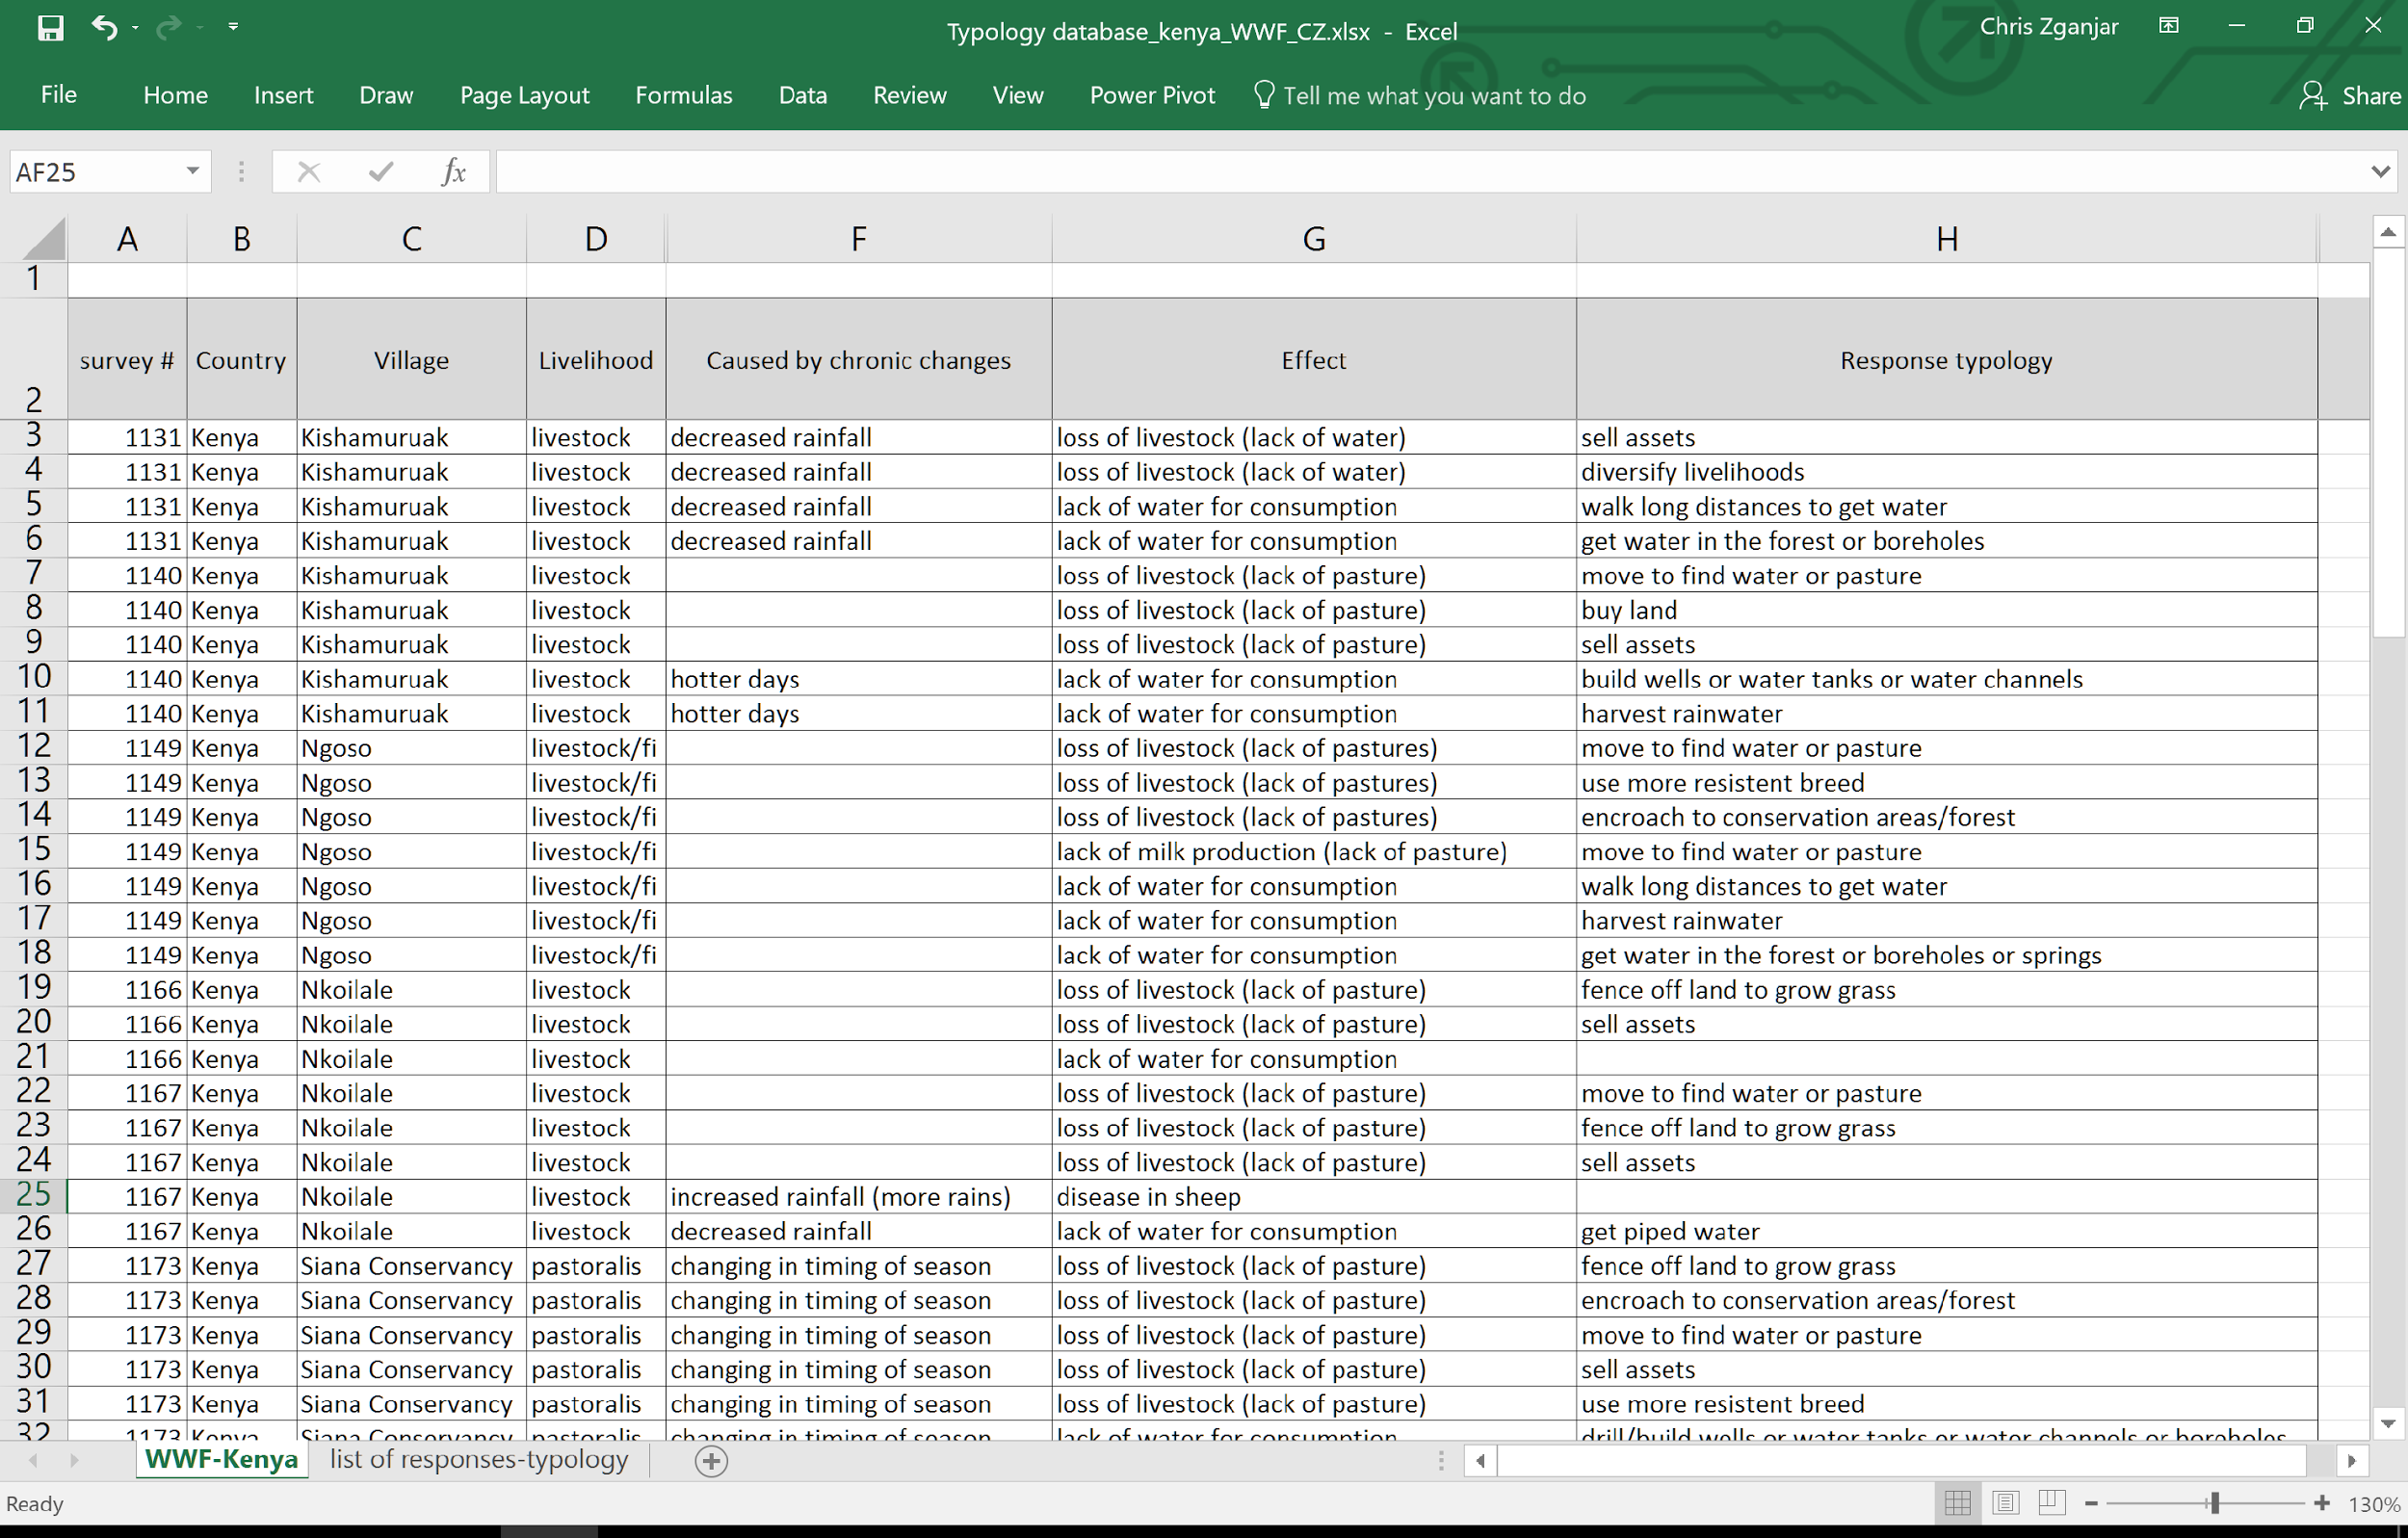

Slide 30
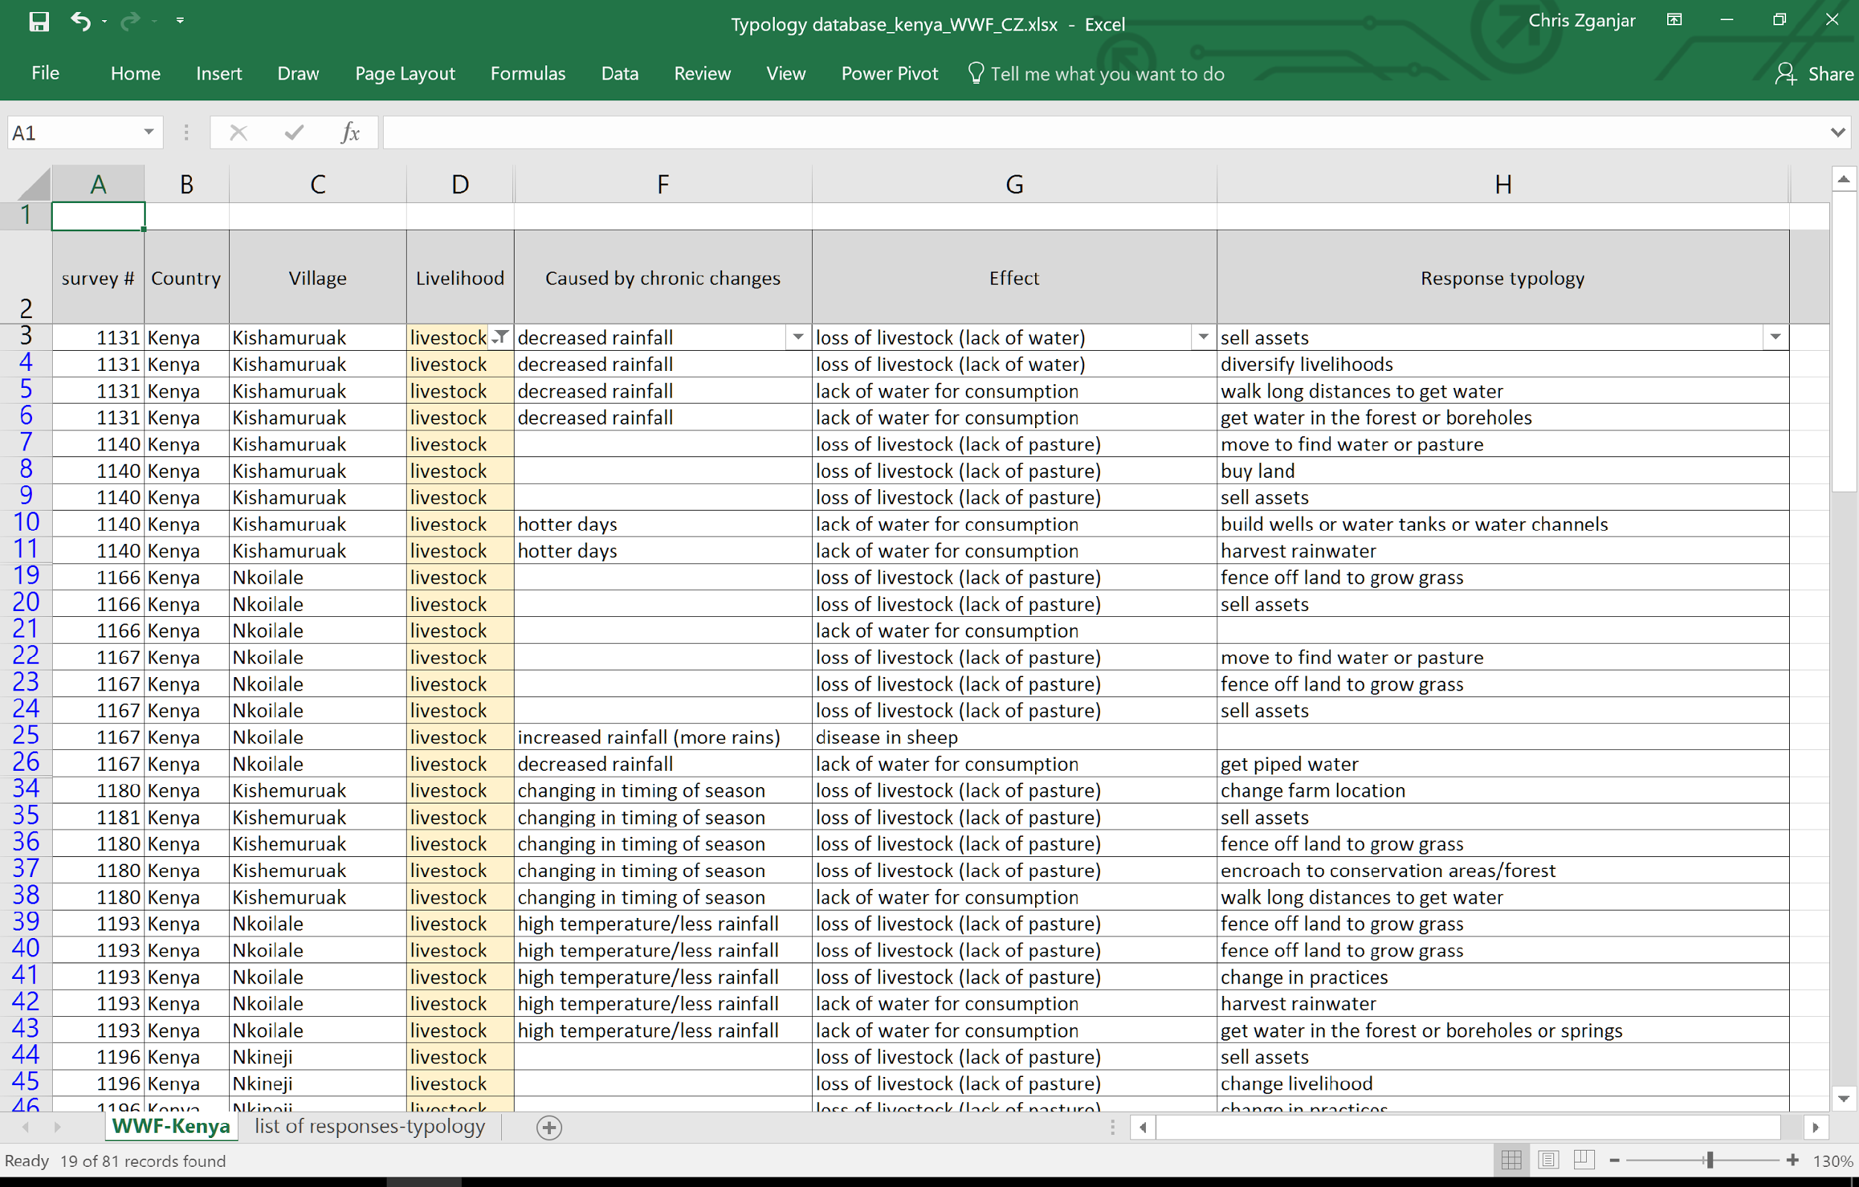

Slide 35
Change in Rainfall by Mid-Century

Slide 36
Protected Areas

Slide 37
Where do we go from here?
Next steps
continue to review surveys and build the typology
prepare climate maps for all other sites
associate responses with current climate trends
identify locations where certain responses may happen in the future
Expected outcomes
identification of where responses with negative impacts on biodiversity may occur in future
Implications of recommendations
identification of alternative responses that should be encouraged
Notes:
Chris, i have included those in here but feel free to change as you wish, Camila.

Slide 38
Questions
What is the most effective method for communicating results and recommendations to USAID and other policy/decision makers?
How can ABCG connect to African missions?
Who are the key stakeholders (practitioners? policy makers? at what level?) that may benefit from this information and that should be invited to our final dissemination workshop?
Notes:
one additional question can be: who are the key stakeholders (practitioners? policy makers? at what level?) that may benefit from this information and that should be invited to our workshop?

Slide 39
Thank you

